Slide 1
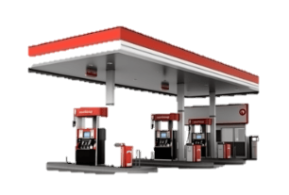
Refining Of Petroleum
Science
Presented By – Tanmay Pawar
Class – 8th

Slide 2
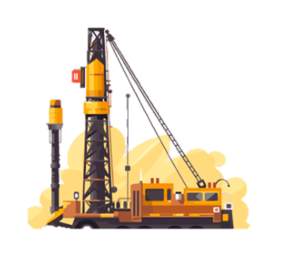
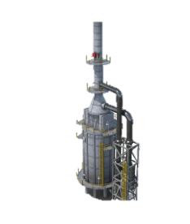
Introduction
Topics Covered
What is petroleum?
Introduction to fossil fuel
How petroleum has obtained

Slide 3
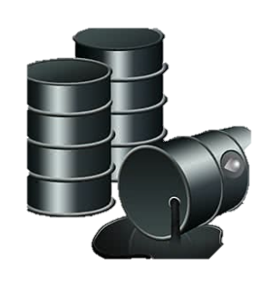
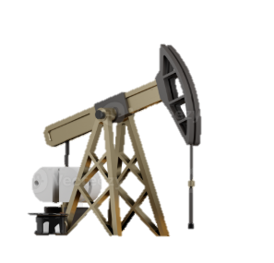
What is petroleum?
a naturally occurring, yellowish-black liquid fossil fuel primarily composed of hydrocarbons.
It was obtained by drilling into the ground straight.
It was refined through Oil Refinery’s to refine the petroleum.

Slide 4
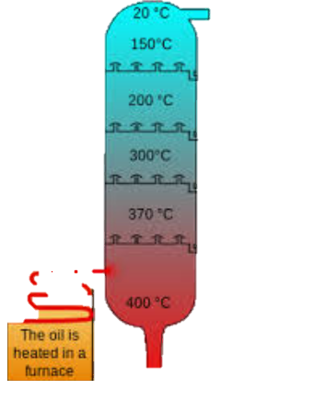
Process of refining of Petroleum
Crude oil is heated and fed into a tall distillation tower.
Inside, oil components (fractions) separate based on their boiling points.
Lighter fractions, like gases and gasoline, vaporize and rise to the top, where they condense.
Medium-weight liquids, such as kerosene and diesel, collect in the tower's middle.
Heavier fractions, like gas oils and residue (used for asphalt), settle at the bottom.

Slide 5
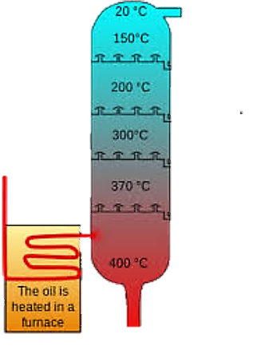
Why refining is important?
because crude oil, as it comes from the ground, is a complex mixture of various hydrocarbons and impurities that are not directly usable.
Refining is same as filtering the water, but in that case we have many products to produce.
Refining makes possible to generate many others fuels like (gases and gasolins)

Slide 6
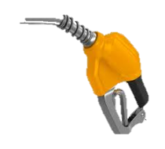
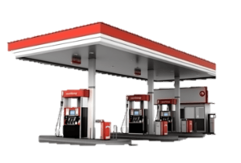
Products obtained by refining
Petrol – Fuel for vehicles
Diesel – Fuel for trucks, buses
Kerosene – Fuel for cooking, lamps
Paraffin wax – Candles, ointments
Lubricating oil – For machines
Bitumen – Road surfacing

Slide 7
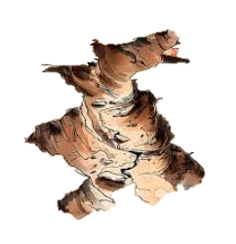

Fossil Fuel
non-renewable energy sources formed from the remains of ancient plants and animals over millions of years.
Remain of these ancient plants are there fossil.
They get converted into fuel by natural activities.

Slide 8
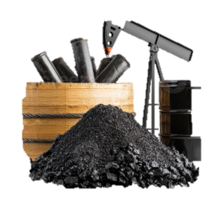
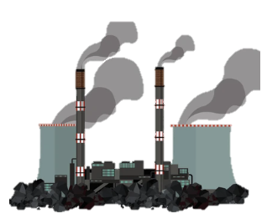
How the fossil fuel is generated?
formed from the remains of ancient organisms, primarily plants and animals, that lived millions of years ago.
anaerobic decomposition of organic matter.

Slide 9
The End
Tanmay Pawar
8th STD
Raosaheb Dada Pawar English Medium School

